Slide 1
Relational Database Design

Slide 2
Outline
Features of Good Relational Design
Atomic Domains and First Normal Form
Decomposition Using Functional Dependencies
Functional Dependency Theory
Algorithms for Functional Dependencies
Decomposition Using Multivalued Dependencies
More Normal Form
Database-Design Process
Modeling Temporal Data

Slide 3
The University Schema
classroom(building, room_number, capacity)
department(dept_name, building, budget)
course(course_id, title, dept_name, credits)
instructor(ID, name, dept_name, salary)
section(course_id, sec_id, semester, year, building, room_number, time_slot_id)
teaches(ID, course_id, sec_id, semester, year)
student(ID, name, dept_name, tot_cred)
takes(ID, course_id, sec_id, semester, year, grade)
advisor(s_ID, i_ID)
time slot(time_slot_id, day, start_time, end_time)
prereq(course_id, prereq_id)

Slide 4
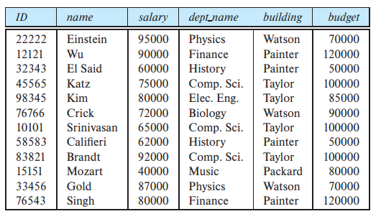
Features of Good Relational Designs
Assume, we are not maintaining two different schema, namely instructor and department.
We are maintaining a schema, namely, in_dep, that can be visualized as a result of a natural join on the relations corresponding to instructor and department.
in_dep (ID, name, salary, dept_name, building, budget)
A few instances of in_dep relation is shown in table given beside.

Slide 5
Features of Good Relational Designs
Any issue, if we maintain schema like this?
Redundant information
We must repeat the department information (“building” and “budget”) once for each instructor in the department.
May lead to inconsistency
For the instructors in a particular department, all the tuples must agree to the budget amount
Suppose we are creating a new department in the university. We cannot represent directly the information concerning a department (dept name, building, budget) unless that department has at least one instructor at the university.

Slide 6
Question
Why is this design bad?
Data(sid,sname,address,cid,cname,grade)
Why is this one preferable?
Student(sid,sname,address)
Course(cid,cname)
Enrolled(sid,cid,grade)

Slide 7
Decomposition
In general, a schema that exhibits repetition of information may have to be decomposed into several smaller schemas.
For example, in_dep schema is to be decomposed into two schemas (in this case, the instructor and department schemas)
Is it always possible to decompose a schema?
No, extreme case in which all schemas consist of one attribute
A less extreme case, consider decomposition of employee schema employee (ID, name, street, city, salary) into the following two schemas:
employee1 (ID, name)
employee2 (name, street, city, salary)

Slide 8

Decomposition
Decomposition of employee schema employee (ID, name, street, city, salary) into the following two schemas:
employee1 (ID, name)
employee2 (name, street, city, salary)
Any flaw?
enterprise has two employees with the same name.

Slide 9
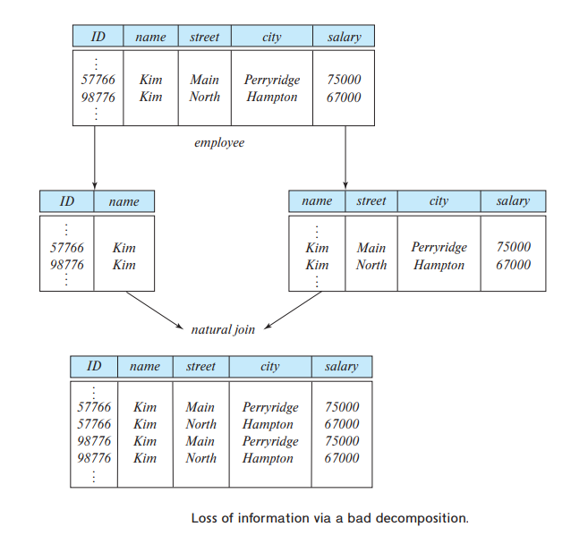
Decomposition
What if we try to regenerate the original tuples using a natural join?
The decomposition is lossy since the join result has lost information about which employee identifiers correspond to which addresses and salaries.
This kind of decompositions are referred as lossy decompositions, and, conversely, to those that are not as lossless decompositions.

Slide 10
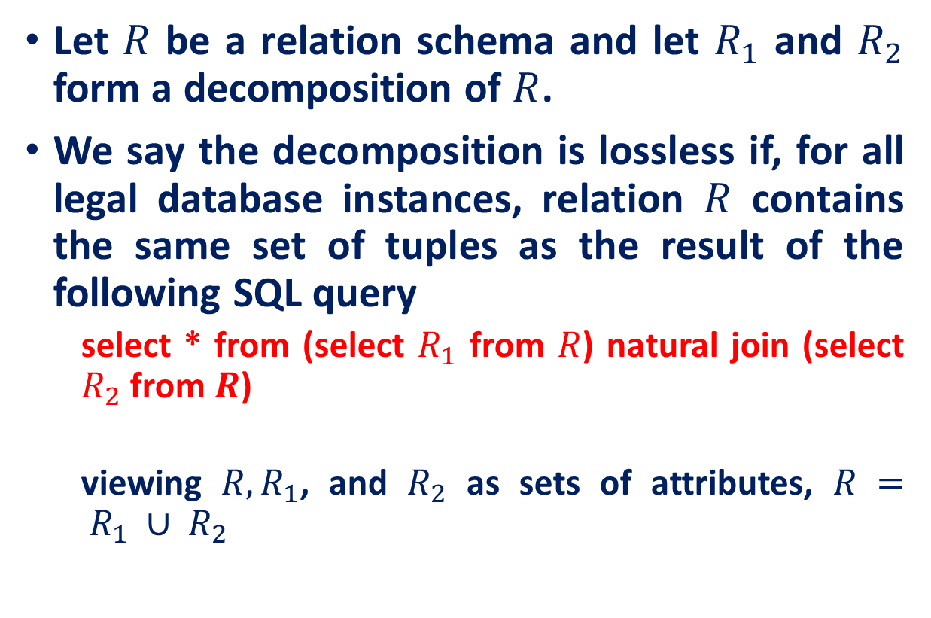
Lossless Decomposition
Let $R$ be a relation schema and let $R_{1}$ and $R_{2}$ form a decomposition of $R$.
We say the decomposition is lossless if, for all legal database instances, relation $R$ contains the same set of tuples as the result of the following SQL query
select * from (select $R_{1}$ from $R$) natural join (select $R_{2}$ from $R$)
viewing $R, R_{1}$, and $R_{2}$ as sets of attributes, $R = R_{1} ∪ R_{2}$

Slide 11
Normalization
This is the process which allows you to get rid of redundant data within your database.
The results of a well executed normalization process are the same as those of a well planned E-R model
This involves restructuring the tables to successively meeting higher forms of Normalization.
A properly normalized database should have the following characteristics
Scalar values in each fields
Absence of redundancy.
Minimal use of null values.
Minimal loss of information.

Slide 12
Normalization: Process
Eliminate Repeating Groups
Make a separate table for each set of related attributes and give each table a primary key.
Eliminate Redundant Data
If an attribute depends on only part of a multivalued key, remove it to a separate table.
Eliminate Columns not dependent on key
If attributes do not contribute to a description of the key, remove them to a separate table.

Slide 13
Normalization: Process
Isolate Independent multiple relationships
No table may contain two or more 1:n or n:m relationships that are not directly related.
Isolate Semantically Related Multiple Relationships
There may be practical constraints on information that justify separating logically related many-to-many relationships.

Slide 14
Normalization: Levels
Levels of normalization based on the amount of redundancy in the database.
Relational theory defines a number of structure conditions called Normal Forms that assure that certain data anomalies do not occur in a database.
Various levels of normalization are:
First Normal Form (1NF)
Second Normal Form (2NF)
Third Normal Form (3NF)
Boyce-Codd Normal Form (BCNF)
Fourth Normal Form (4NF)
Fifth Normal Form (5NF)
Domain Key Normal Form (DKNF)
Most databases should be 3NF or BCNF in order to avoid the database anomalies.

Slide 15
Results of Normalization
Removes the following modification anomalies (integrity errors) with the database
Insertion
Deletion
Update

Slide 16
ANOMALIES
Insertion
An insertion anomaly is the inability to add data to the database due to absence of other data.
Deletion
A deletion anomaly occurs when you delete a record that may contain attributes that shouldn't be deleted.
Update
Updating the values of one fact requires multiple changes to the database

Slide 17
ANOMALIES EXAMPLES
TABLE: COURSE
COURSE# | SECTION# | C_NAME
CIS564 | 072 | Database Design
CIS564 | 073 | Database Design
CIS570 | 072 | Oracle Forms
CIS564 | 074 | Database Design

Slide 18
ANOMALIES EXAMPLES
Insertion: Suppose our university has approved a new course called CIS563: SQL & PL/SQL. Can this information about the new course be entered (inserted) into the table COURSE in its present form?
COURSE# | SECTION# | C_NAME
CIS564 | 072 | Database Design
CIS564 | 073 | Database Design
CIS570 | 072 | Oracle Forms
CIS564 | 074 | Database Design

Slide 19
ANOMALIES EXAMPLES
Deletion: Suppose not enough students enrolled for the course CIS570 which had only one section 072.
So, the school decided to drop this section and delete the section# 072 for CIS570 from the table COURSE. But then, what other relevant info also got deleted in the process?
COURSE# | SECTION# | C_NAME
CIS564 | 072 | Database Design
CIS564 | 073 | Database Design
CIS570 | 072 | Oracle Forms
CIS564 | 074 | Database Design

Slide 20
ANOMALIES EXAMPLES
Update: Suppose the course name (C_Name) for CIS 564 got changed to Database Management.
How many times do you have to make this change in the COURSE table in its current form?
COURSE# | SECTION# | C_NAME
CIS564 | 072 | Database Design
CIS564 | 073 | Database Design
CIS570 | 072 | Oracle Forms
CIS564 | 074 | Database Design

Slide 21
ANOMALIES
So, a table (relation) is a stable (‘good’) table only if it is free from any of these anomalies at any point in time.
You have to ensure that each and every table in a database is always free from these modification anomalies. And, how do you ensure that?
‘Normalization’ theory helps.

Slide 22
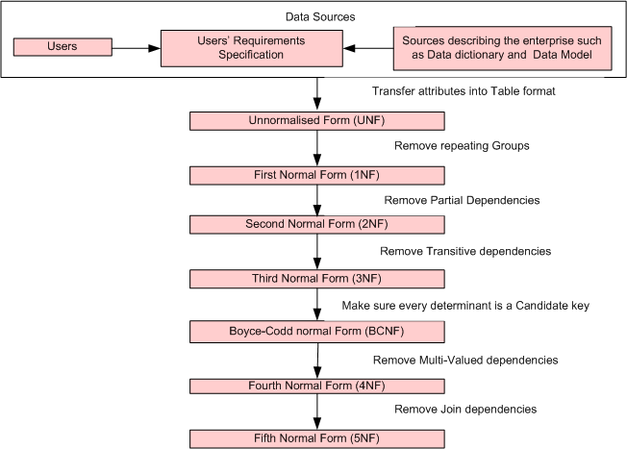
Steps in the Data Normalization Process
Each higher level is a subset of the lower level

Slide 23
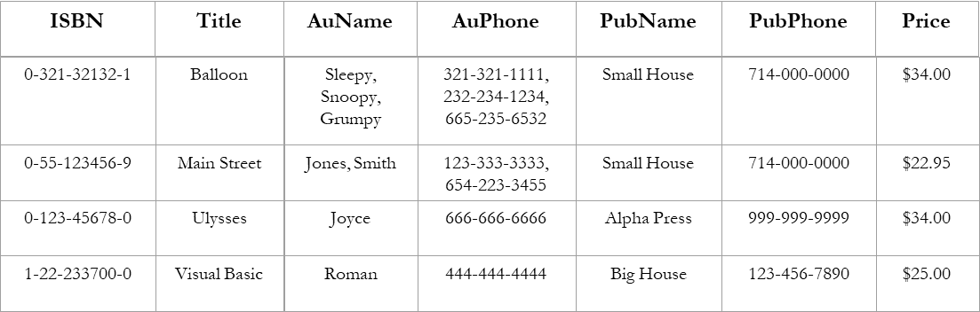
First Normal From
A table is in the first normal form iff
The domain of each attribute contains only atomic values, and
The value of each attribute contains only a single value from that domain.
Example (Not 1NF)
Author and AuPhone columns are not scalar

Slide 24
First Normal From
Place all items appearing in the repeating group in a new table
Designate a primary key for each new table produced.
Create a relationship between the two tables
For 1:N relation duplicate the P.K. from 1 side to many side
For M:N relation create a new table with P.K. from both tables
ISBN
Title
PubName
PubPhone
Price
0-321-32132-1
Balloon
Small House
714-000-0000
$34.00
0-55-123456-9
Main Street
Small House
714-000-0000
$22.95
0-123-45678-0
Ulysses
Alpha Press
999-999-9999
$34.00
1-22-233700-0
Visual Basic
Big House
123-456-7890
$25.00
ISBN
AuName
AuPhone
0-321-32132-1
Sleepy
321-321-1111
0-321-32132-1
Snoopy
232-234-1234
0-321-32132-1
Grumpy
665-235-6532
0-55-123456-9
Jones
123-333-3333
0-55-123456-9
Smith
654-223-3455
0-123-45678-0
Joyce
666-666-6666
1-22-233700-0
Roman
444-444-4444

Slide 25
Functional Dependencies
If one set of attributes in a table determines another set of attributes in the table, then the second set of attributes is said to be functionally dependent on the first set of attributes.
We’d expect the following functional dependencies to hold in our Student database
sid → name, dep_name, tot_cred
cid → title, dep_name, credits
…
A functional dependency X → Y is simply a pair of sets (of field names)
Note: the sloppy notation A,B → C,D rather than {A,B} → {C,D}

Slide 26
Functional Dependencies: Properties
Example
PubID
PubName
PubPhone
Table Scheme: {PubID, PubName, PubPhone}
Functional Dependencies: {PubId} → {PubPhone}
{PubId} → {PubName}
{PubName, PubPhone} → {PubID}
1
Big House
999-999-9999
2
Small House
123-456-7890
3
Alpha Press
111-111-1111
AuID
AuName
AuPhone
Table Scheme: {AuID, AuName, AuPhone}
Functional Dependencies: {AuId} → {AuPhone}
{AuId} → {AuName}
{AuName, AuPhone} → {AuID}
1
Sleepy
321-321-1111
2
Snoopy
232-234-1234
3
Grumpy
665-235-6532
4
Jones
123-333-3333
5
Smith
654-223-3455
6
Joyce
666-666-6666
7
Roman
444-444-4444

Slide 27
Second Normal Form (2NF)
For a table to be in 2NF, there are two requirements:
The database is in first normal form
All nonkey attributes in the table must be functionally dependent on the entire primary key
Example 1 (Not 2NF)
Scheme → {StudentId, CourseId, StudentName, CourseTitle, Grade}
Key → {StudentId, CourseId}
{StudentId} → {StudentName}
{CourseId} → {CourseTitle}
{StudentId, CourseId} → {Grade}
StudentName depends on a subset of the key I.e. StudentId
CourseTitle depends on a subset of the key. i.e. CourseId

Slide 28
2NF: Decomposition
If a data item is fully functionally dependent on only a part of the primary key, move that data item and that part of the primary key to a new table.
If other data items are functionally dependent on the same part of the key, place them in the new table also
Make the partial primary key copied from the original table as the primary key for the new table. (Place all items that appear in the repeating group in a new table)
Old Schema → {StudentId, CourseId, StudentName, CourseTitle, Grade}
New Schema → {StudentId, StudentName}
New Schema → {CourseId, CourseTitle}
New Schema → {StudentId, CourseId, Grade}

Slide 29
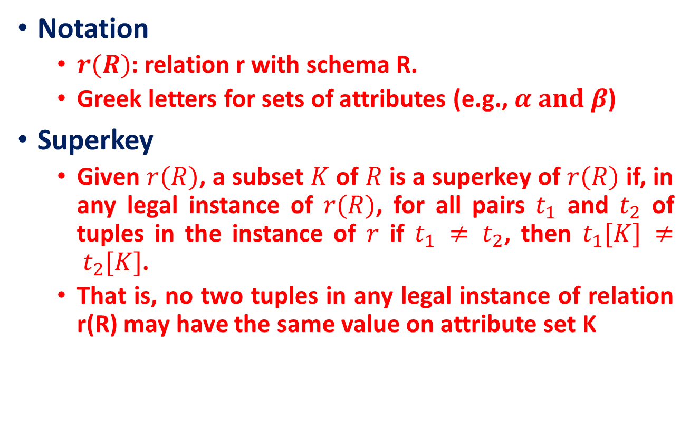
Keys and Functional Dependencies
Notation
$r(R)$: relation r with schema R.
Greek letters for sets of attributes (e.g., $α and β$)
Superkey
Given $r(R)$, a subset $K$ of $R$ is a superkey of $r(R)$ if, in any legal instance of $r(R)$, for all pairs $t_{1}$ and $t_{2}$ of tuples in the instance of $r$ if $t_{1} ≠ t_{2}$, then $t_{1}[K] ≠ t_{2}[K]$.
That is, no two tuples in any legal instance of relation r(R) may have the same value on attribute set K
A superkey is a set of attributes that uniquely identifies an entire tuple, a functional dependency allows us to express constraints that uniquely identify the values of certain attributes

Slide 30
Functional Dependencies
Let R be a relation schema
α ⊆ R and β ⊆ R
The functional dependency
α → β
holds on R if and only if for any legal relations r(R), whenever any two tuples t₁ and t₂ of r agree on the attributes α, they also agree on the attributes β. That is,
t₁[α] = t₂ [α] ⇒ t₁[β ] = t₂ [β ]
Example: Consider r(A,B ) with the following instance of r.
On this instance, A → B does NOT hold, but B → A does hold.
4
1 5
3 7

Slide 31
Functional Dependencies
K is a superkey for relation schema R if and only if K → R
K is a candidate key for R if and only if
K → R, and
for no α ⊂ K, α → R
A superkey is a set of attributes that uniquely identifies an entire tuple, a functional dependency allows us to express constraints that uniquely identify the values of certain attributes

Slide 32
Functional Dependencies
considered the schema:
in_dep (ID, name, salary, dept_name, building, budget)
in which the functional dependency dept_name → budget holds because for each department (identified by dept_name) there is a unique budget amount.

Slide 33
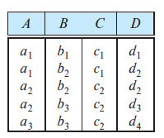
Functional Dependencies
Is A → C satisfied ?
Is C → A satisfied ?
Is AC → D satisfied ?
YES
NO
NO

Slide 34
Functional Dependencies
Some functional dependencies are said to be trivial because they are satisfied by all relations.
For example, A → A is satisfied by all relations involving attribute A.
In general, a functional dependency of the form α → β is trivial if β ⊆ α.
If α → β holds as a constraint on the database, then for any schema R such that α ⊆ R and β ⊆ R, α → β must hold

Slide 35
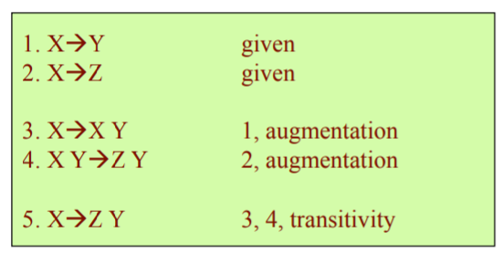
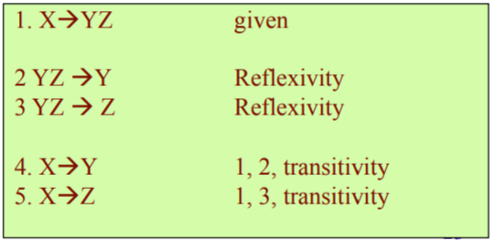
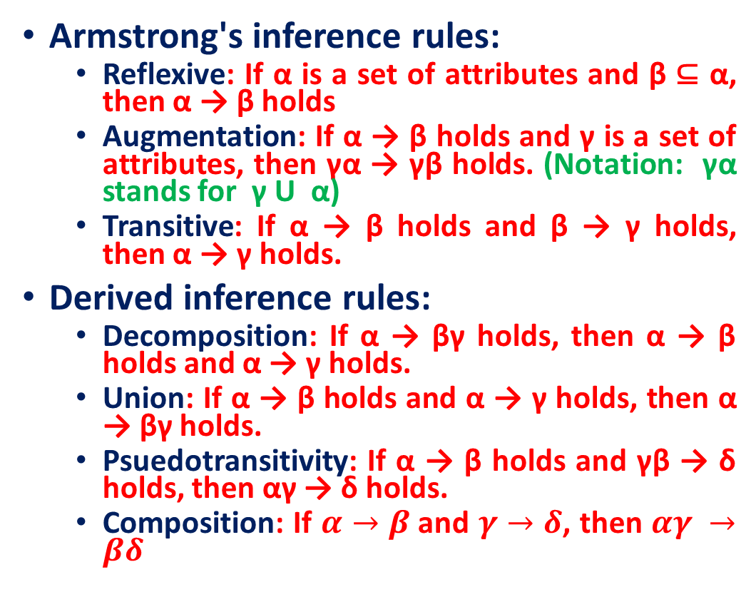
Functional Dependency: Inference Rules
Armstrong's inference rules:
Reflexive: If α is a set of attributes and β ⊆ α, then α → β holds
Augmentation: If α → β holds and γ is a set of attributes, then γα → γβ holds. (Notation: γα stands for γ U α)
Transitive: If α → β holds and β → γ holds, then α → γ holds.
Derived inference rules:
Decomposition: If α → βγ holds, then α → β holds and α → γ holds.
Union: If α → β holds and α → γ holds, then α → βγ holds.
Psuedotransitivity: If α → β holds and γβ → δ holds, then αγ → δ holds.
Composition: If $α→β$and $γ→δ$, then $αγ →βδ$

Slide 36
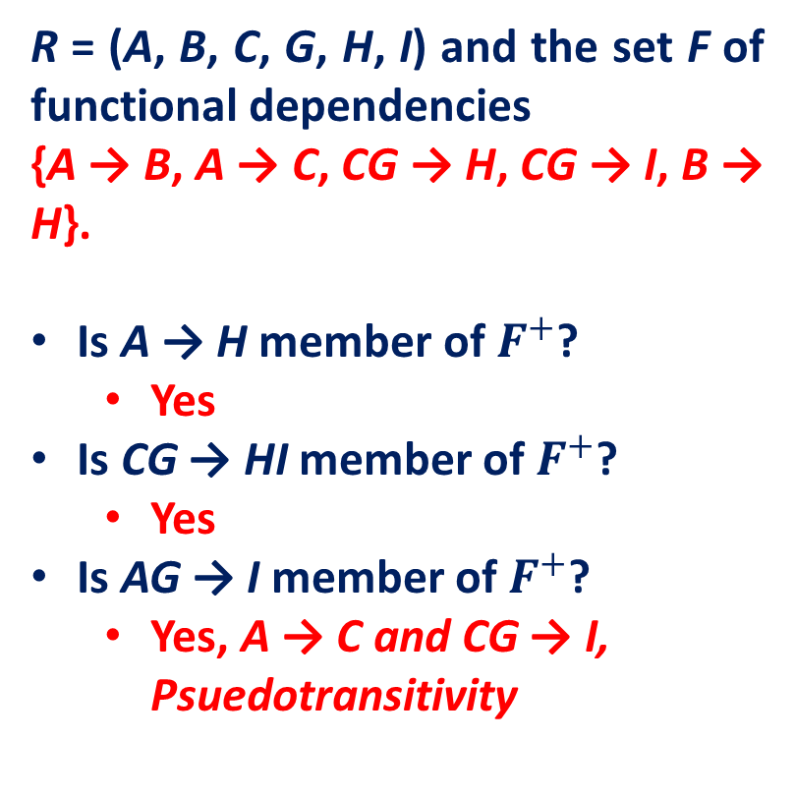
Closure of a Set of Functional Dependencies
Closure of a set F of FDs is the set F⁺ of all FDs that can be inferred from F, i.e., the set of all FDs implied by F.
When testing for normal forms, it is not sufficient to consider the given set of functional dependencies; rather, we need to consider all functional dependencies that hold on the schema.
R = (A, B, C, G, H, I) and the set F of functional dependencies
{A → B, A → C, CG → H, CG → I, B → H}.
Is A → H member of $F^{+}$?
Yes
Is CG → HI member of $F^{+}$?
Yes
Is AG → I member of $F^{+}$?
Yes, A → C and CG → I, Psuedotransitivity

Slide 37
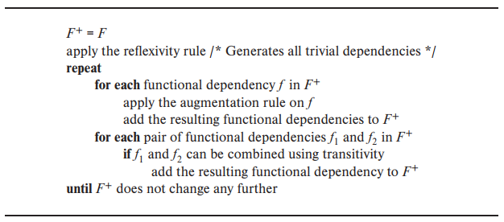
A procedure to compute $F^{+}$

Slide 38
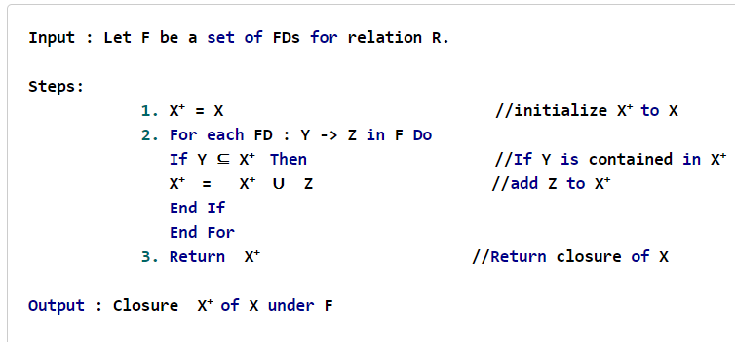
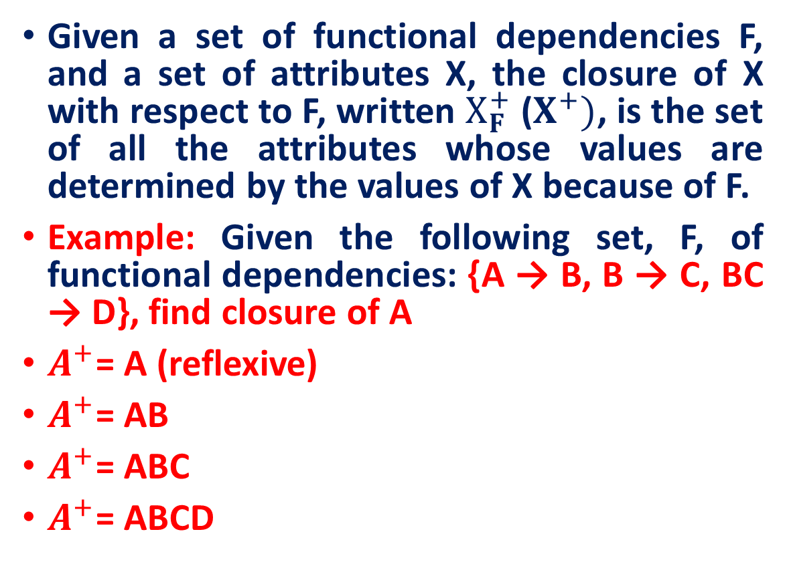
Closure of an Attribute Set
Given a set of functional dependencies F, and a set of attributes X, the closure of X with respect to F, written $X_{F}^{+}$ ($X^{+})$, is the set of all the attributes whose values are determined by the values of X because of F.
Example: Given the following set, F, of functional dependencies: {A → B, B → C, BC → D}, find closure of A
$A^{+}$= A (reflexive)
$A^{+}$= AB
$A^{+}$= ABC
$A^{+}$= ABCD

Slide 39
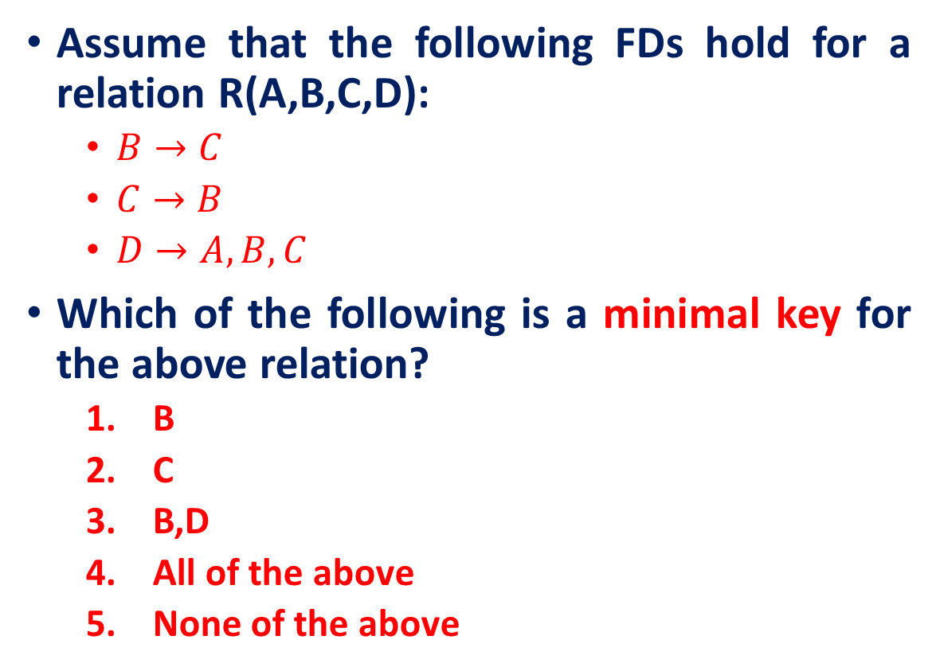
Closure of an Attribute Set
Assume that the following FDs hold for a relation R(A,B,C,D):
$B→C$
$C→B$
$D→A,B,C$
Which of the following is a minimal key for the above relation?
B
C
B,D
All of the above
None of the above
Does not determine all
Does not determine all
Not minimal
The right answer

Slide 40
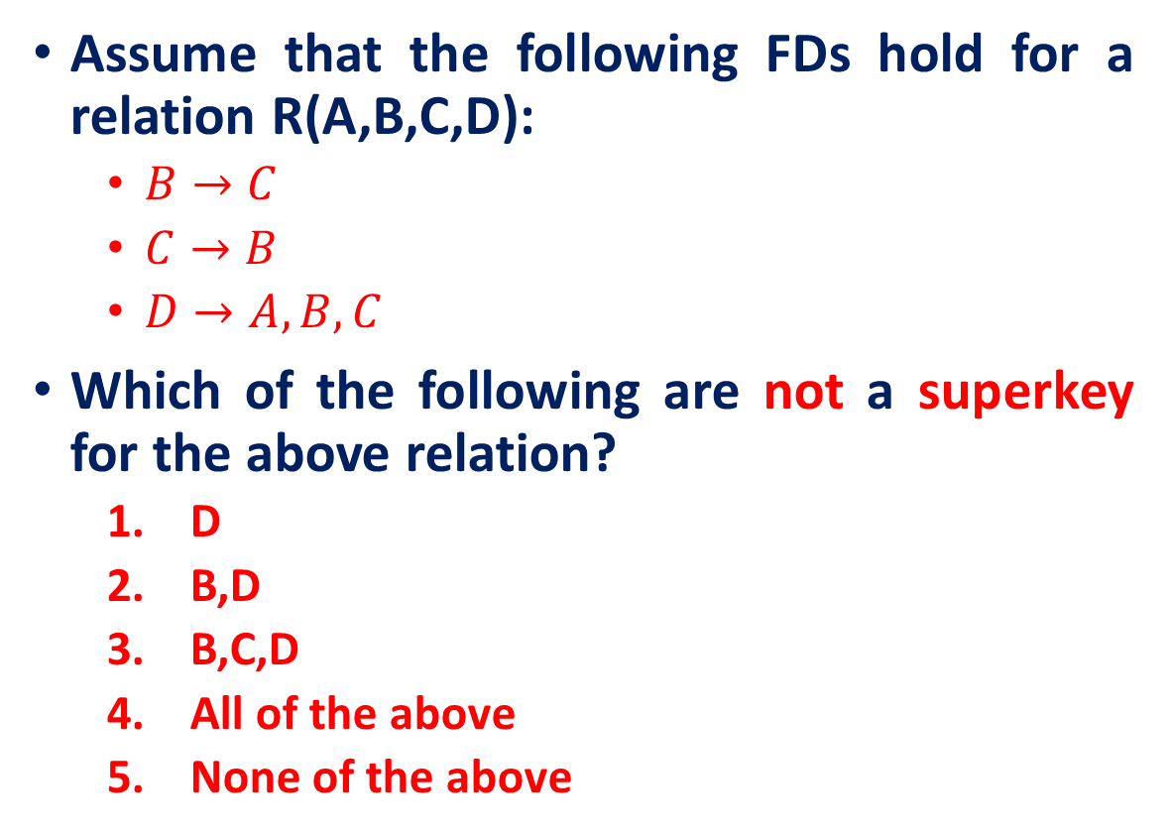
Closure of an Attribute Set
Assume that the following FDs hold for a relation R(A,B,C,D):
$B→C$
$C→B$
$D→A,B,C$
Which of the following are not a superkey for the above relation?
D
B,D
B,C,D
All of the above
None of the above
D is a key. Therefore, all of the answers are superkeys

Slide 41
Minimal Sets of FDs
Suppose that we have a set of functional dependencies F on a relation schema.
Whenever a user performs an update on the relation, the database system must ensure that the update does not violate any functional dependencies, that is, all the functional dependencies in F are satisfied in the new database state.
Question. Can reduce the effort spent in checking for violations?
Yes, by testing a simplified set of functional dependencies that has the same closure as the given set.

Slide 42
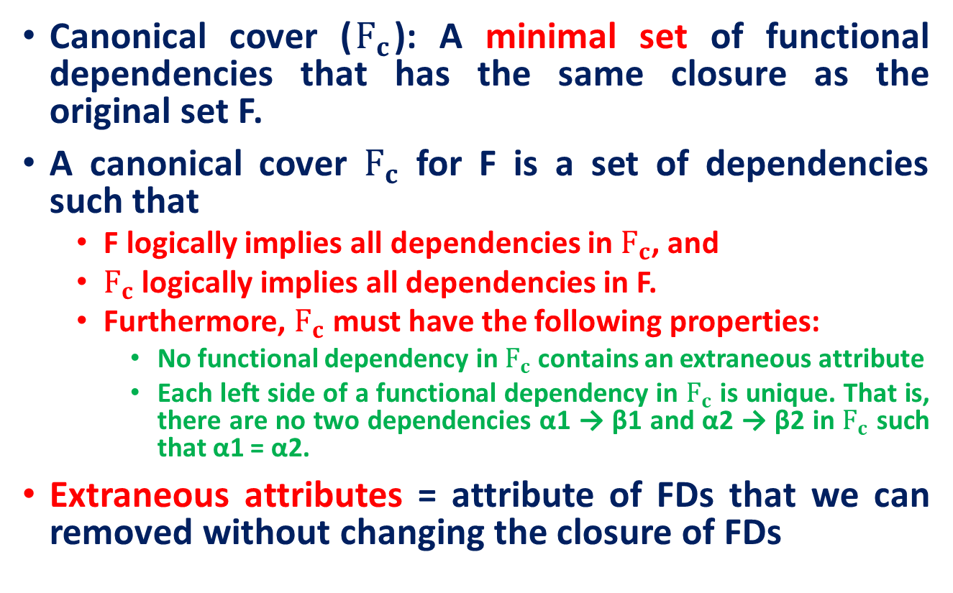
Minimal Sets of FDs: Canonical cover
Canonical cover ($F_{c}$): A minimal set of functional dependencies that has the same closure as the original set F.
A canonical cover $F_{c}$ for F is a set of dependencies such that
F logically implies all dependencies in $F_{c}$, and
$F_{c}$logically implies all dependencies in F.
Furthermore, $F_{c}$ must have the following properties:
No functional dependency in $F_{c}$ contains an extraneous attribute
Each left side of a functional dependency in $F_{c}$ is unique. That is, there are no two dependencies α1 → β1 and α2 → β2 in $F_{c}$ such that α1 = α2.
Extraneous attributes = attribute of FDs that we can removed without changing the closure of FDs

Slide 43
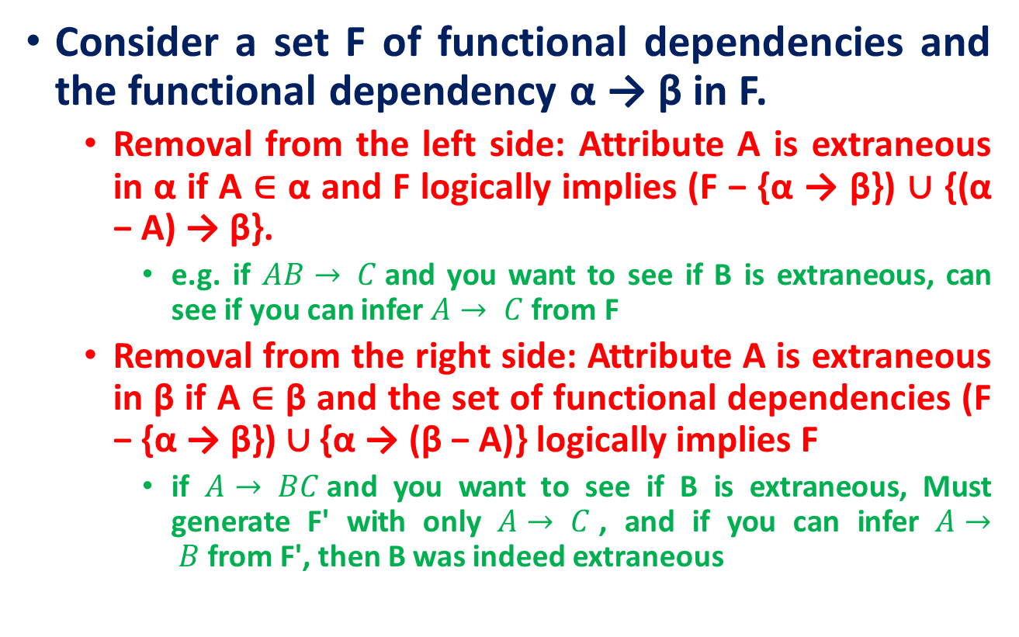
Extraneous attributes
Consider a set F of functional dependencies and the functional dependency α → β in F.
Removal from the left side: Attribute A is extraneous in α if A ∈ α and F logically implies (F − {α → β}) ∪ {(α − A) → β}.
e.g. if $AB→ C$and you want to see if B is extraneous, can see if you can infer $A→ C$from F
Removal from the right side: Attribute A is extraneous in β if A ∈ β and the set of functional dependencies (F − {α → β}) ∪ {α → (β − A)} logically implies F
if $A→ BC$and you want to see if B is extraneous, Must generate F' with only $A→ C$, and if you can infer $A→ B$from F', then B was indeed extraneous

Slide 44
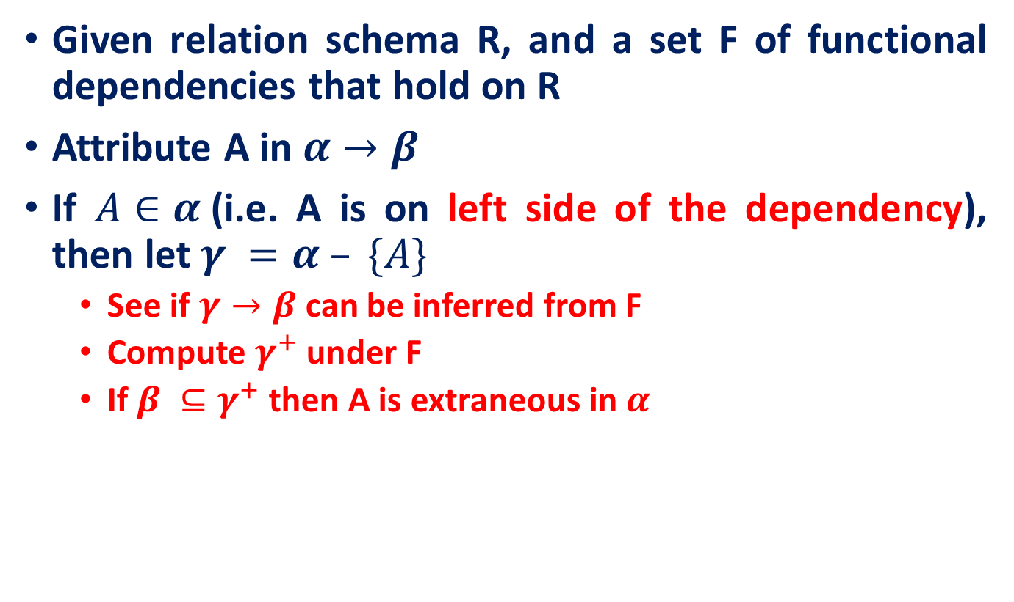
Testing Extraneous Attributes
Given relation schema R, and a set F of functional dependencies that hold on R
Attribute A in $α→β$
If $A∈α$(i.e. A is on left side of the dependency), then let $γ =α – \{A\}$
See if $γ→β$can be inferred from F
Compute $γ^{+}$under F
If $β ⊆γ^{+}$then A is extraneous in $α$

Slide 45
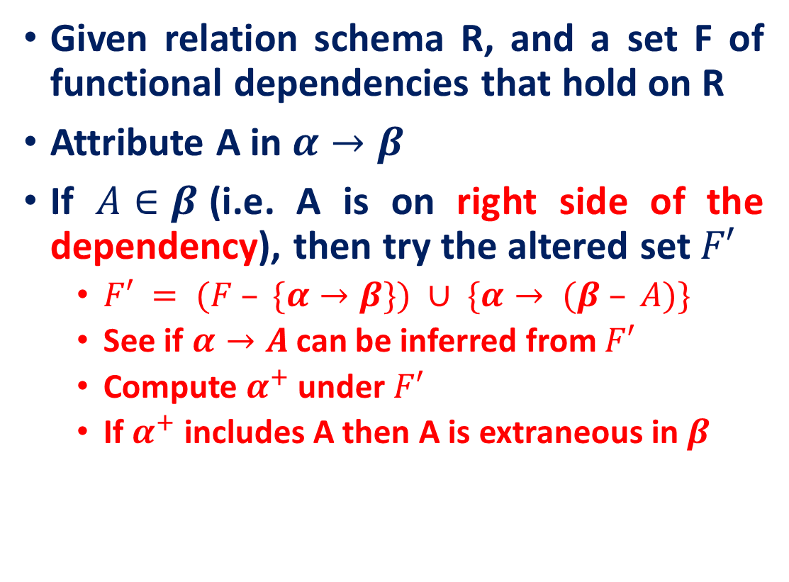
Testing Extraneous Attributes
Given relation schema R, and a set F of functional dependencies that hold on R
Attribute A in $α→β$
If $A∈β$(i.e. A is on right side of the dependency), then try the altered set $F′$
$F′ = (F – \{α→β\}) ∪ \{α→ (β – A)\}$
See if $α→A$can be inferred from $F′$
Compute $α^{+}$under $F′$
If $α^{+}$ includes A then A is extraneous in $β$
F = {AB → CD, A → E, and E → C}.
Is C is extraneous in AB → CD?
Compute the attribute closure of AB under F’ = {AB → D, A → E, and E → C}.
The closure is ABCDE, which includes CD, so we infer that C is extraneous.

Slide 46
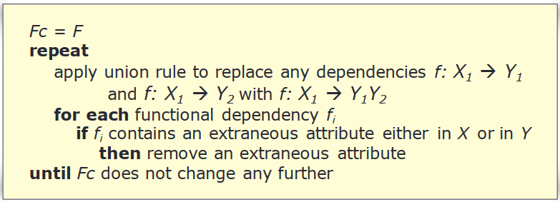
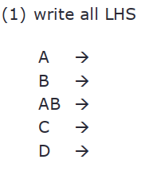
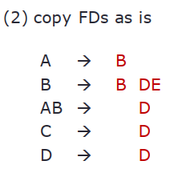
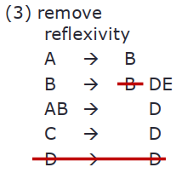
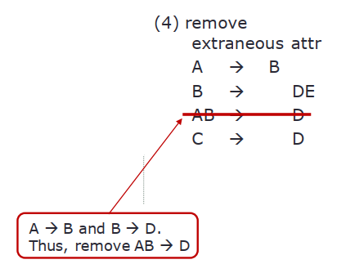

Computing canonical cover
Given R(A,B,C,D,E), FDs = { A $→$ B, AB $→$D, B $→$BDE, C $→$D, D $→$ D }. Compute $F_{c}$

Slide 47
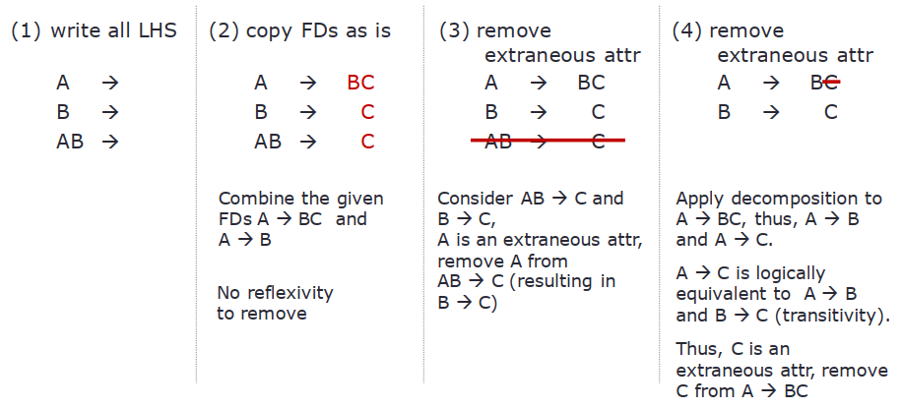
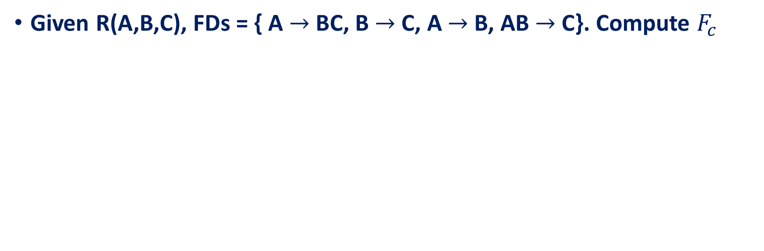
Computing CC
Given R(A,B,C), FDs = { A $→$ BC, B $→$C, A $→$B, AB $→$C}. Compute $F_{c}$

Slide 48
Minimal Sets of FDs
A set of FDs is minimal if it satisfies the following conditions:
Every dependency in F has a single attribute for its RHS.
We cannot remove any dependency from F and have a set of dependencies that is equivalent to F.
We cannot replace any dependency X -> A in F with a dependency Y -> A, where Y proper-subset-of X ( Y subset-of X) and still have a set of dependencies that is equivalent to F.
Every set of FDs has an equivalent minimal set and there can be several equivalent minimal sets

Slide 49
Equivalence of Sets of FDs
Two sets of FDs F and G are equivalent if:
Every FD in F can be inferred from G, and
Every FD in G can be inferred from F
Hence, F and G are equivalent if F⁺ = G⁺
Definition (Covers):
F covers G if every FD in G can be inferred from F
(i.e., if G⁺ subset-of F⁺)
F and G are equivalent if F covers G and G covers F
There is an algorithm for checking equivalence of sets of FDs

Slide 50
Properties of Decomposition
Lossless join
Dependency preserving
After the decomposition, all FDs in F⁺ should be preserved
No redundancy
solved through the normal forms

Slide 51
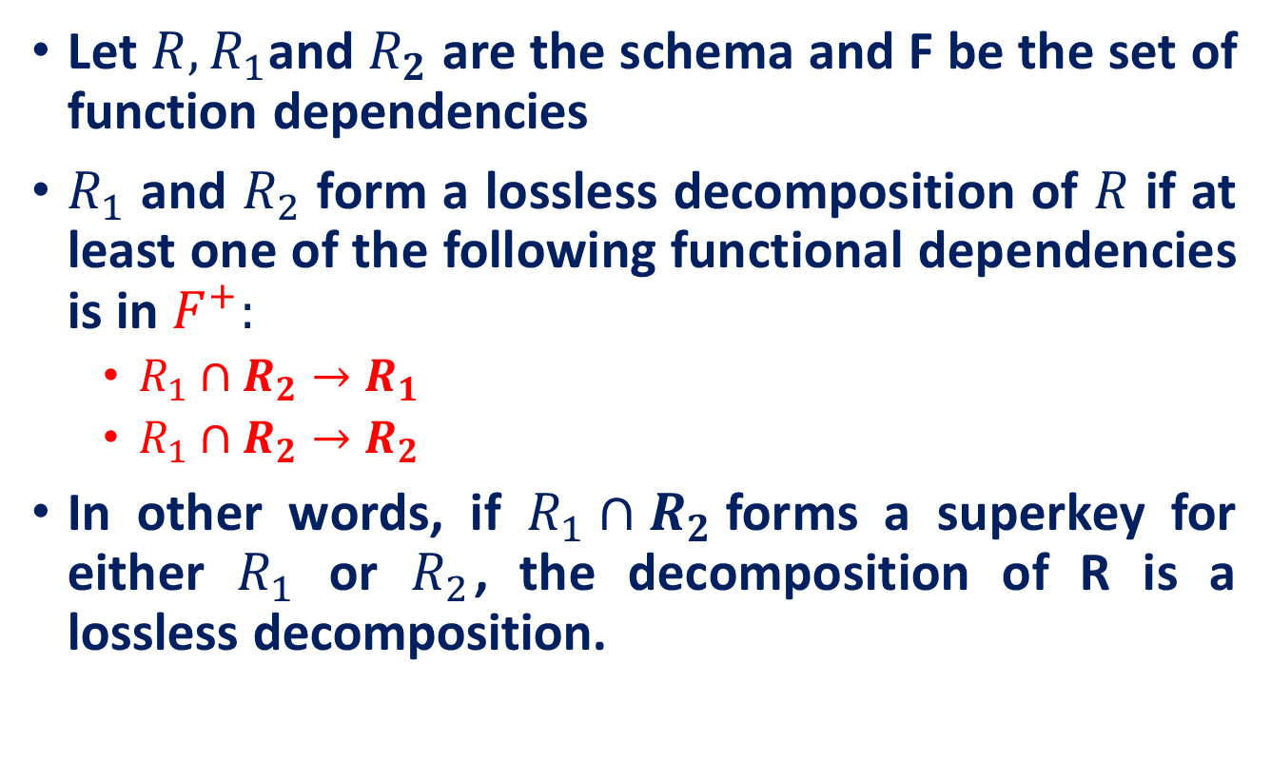
Lossless Decomposition and Functional Dependencies
Let $R, R_{1}$and $R_{2}$ are the schema and F be the set of function dependencies
$R_{1}$ and $R_{2}$ form a lossless decomposition of $R$ if at least one of the following functional dependencies is in $F^{+}:$
$R_{1}∩R_{2}→R_{1}$
$R_{1}∩R_{2}→R_{2}$
In other words, if $R_{1}∩R_{2}$forms a superkey for either $R_{1}$ or $R_{2}$, the decomposition of R is a lossless decomposition.

Slide 52
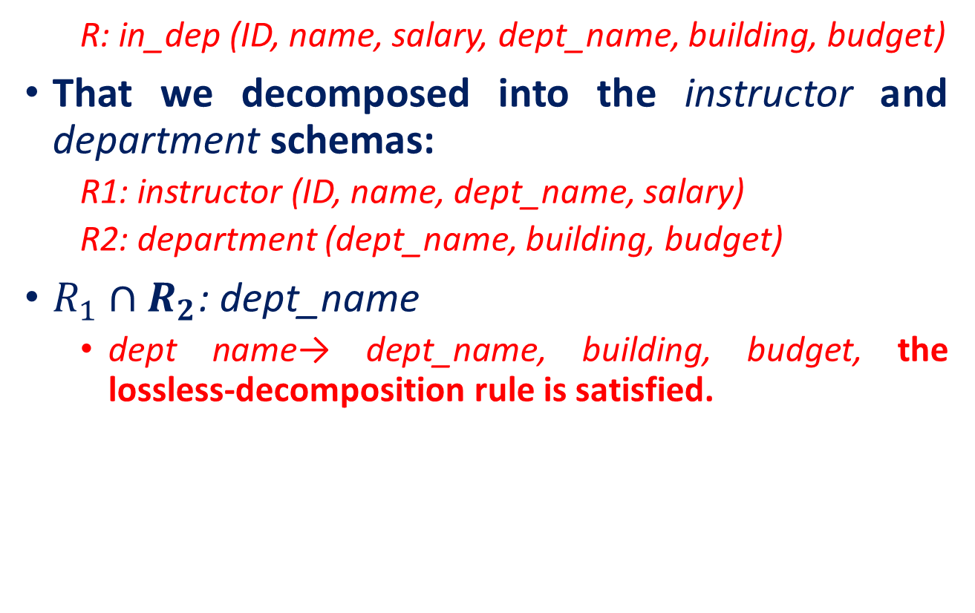
Lossless Decomposition and Functional Dependencies
R: in_dep (ID, name, salary, dept_name, building, budget)
That we decomposed into the instructor and department schemas:
R1: instructor (ID, name, dept_name, salary)
R2: department (dept_name, building, budget)
$R_{1}∩R_{2}$: dept_name
dept name→ dept_name, building, budget, the lossless-decomposition rule is satisfied.

Slide 53
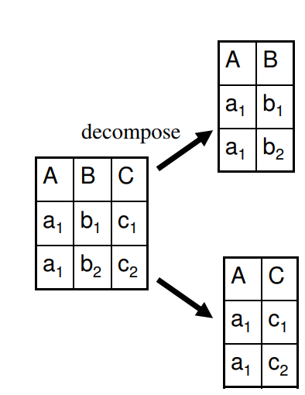
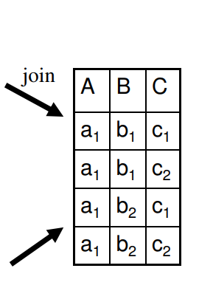
Lossless Decomposition and Functional Dependencies
Is this lossy or lossless decomposition?

Slide 54
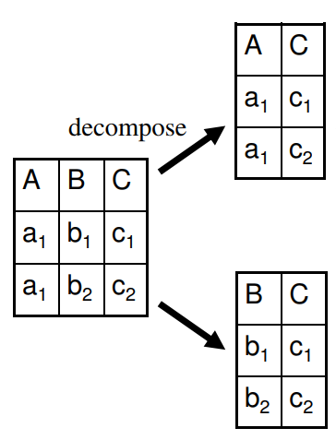
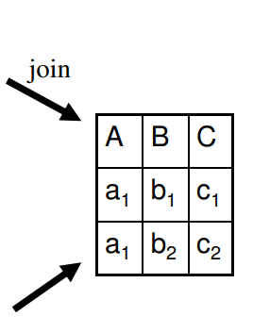
Lossless Decomposition and Functional Dependencies
Is this lossy or lossless decomposition?

Slide 55
Dependency Preserving
Assume R is decomposed to R1 and R2
Dependencies of R1 and R2 include:
Local dependencies α → β
All columns of α and β must be in a single relation
Global Dependencies
Use transitivity property to form more FDs across R1 and R2 relations
Yes ➔ Dependency preserving
Does these dependencies match the ones in R ?
No ➔ Not dependency preserving
Notes:
3

Slide 56
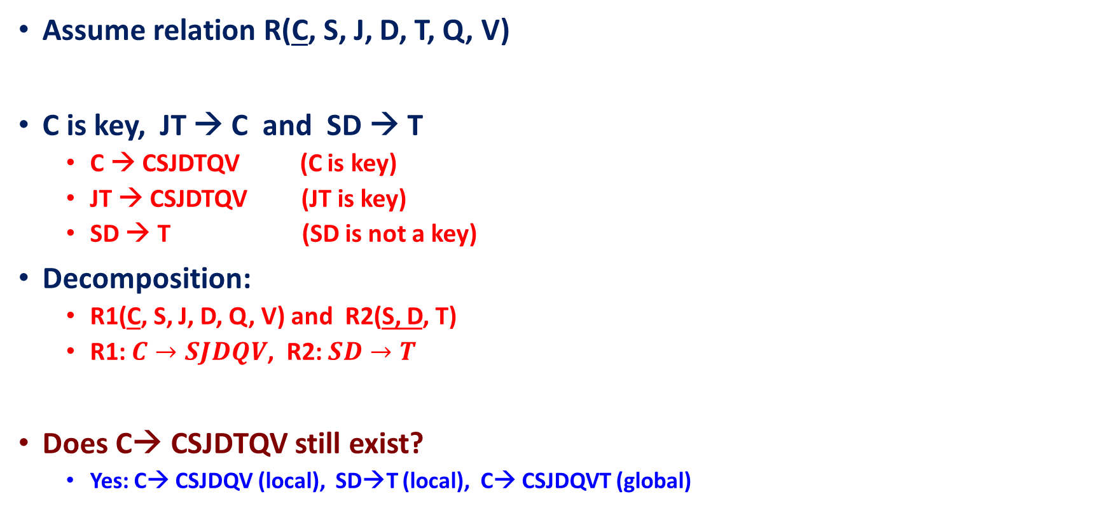
Example of Lost FD
Assume relation R(C, S, J, D, T, Q, V)
C is key, JT → C and SD → T
C → CSJDTQV (C is key)
JT → CSJDTQV (JT is key)
SD → T (SD is not a key)
Decomposition:
R1(C, S, J, D, Q, V) and R2(S, D, T)
R1: $C→SJDQV$, R2: $SD→T$
Does C→ CSJDTQV still exist?
Yes: C→ CSJDQV (local), SD→T (local), C→ CSJDQVT (global)
Lossless
Notes:
3

Slide 57
Example of Lost FD (Cont’d)
Assume relation R(C, S, J, D, T, Q, V)
C is key, JT → C and SD → T
C → CSJDTQV (C is key)
JT → CSJDTQV (JT is key)
SD → T (SD is not a key)
Decomposition:
R1(C, S, J, D, Q, V) and R2(S, D, T)
Does SD→ T still exist?
Yes: SD→T (local)
Lossless
Notes:
3

Slide 58
Example of Lost FD (Cont’d)
Assume relation R(C, S, J, D, T, Q, V)
C is key, JT → C and SD → T
C → CSJDTQV (C is key)
JT → CSJDTQV (JT is key)
SD → T (SD is not a key)
Decomposition:
R1(C, S, J, D, Q, V) and R2(S, D, T)
Does JT→ CSJDTQV still exist?
No, this one is lost (no way from the local FDs to get this one)
Lossless
Notes:
3

Slide 59
Dependency Preservation Test
Assume R is decomposed into R1 and R2
The closure of FDs in R is F⁺
The FDs in R1 and R2 are F_{R1} and F_{R2}, respectively
Then dependencies are preserved if:
F⁺ = (F_{R1} union F_{R2})⁺
local dependencies in R1
local dependencies in R2
Notes:
4

Slide 60
After (_)NF
1NF: each column is atomic, flat
2NF: 1NF + no partial dependency
Every 2NF relation is in 1NF
3NF: 2NF + lossless-join + dependency preserving
Every 3NF relation is in 2NF
BCNF: 3NF + lossless join + redundancy free
Every BCNF relation is in 3NF
4NF: no multi-valued dependency
Every 4NF relation is in BCNF
5NF: 4NF + cannot be further non loss decomposed

Slide 61
Third Normal Form (3NF)
This form dictates that all non-key attributes of a table must be functionally dependent on a candidate key such that there are no interdependencies among non-key attributes i.e., there should be no transitive dependencies
For a table to be in 3NF, there are two requirements
The table should be second normal form
No attribute is transitively dependent on the primary key

Slide 62
Third Normal Form (3NF)
Example (Not in 3NF)
Schema → {Title, PubID, BookType, Price }
Key → {Title, PubId}
{Title, PubId} → {BookType}
{Title, PubID} → {Price}
{BookType} → {Price}
Both Price and BookType depend on a key hence 2NF
Transitively {Title, PubId} → {BookType} and {BookType} → {Price} hence not in 3NF
Title
PubID
BookType
Price
Moby Dick
1
Adventure
34.95
Giant
2
Adventure
34.95
MobyDick
2
Adventure
34.95
Iliad
1
War
44.95
Romeo &Juliet
1
Love
59.90

Slide 63
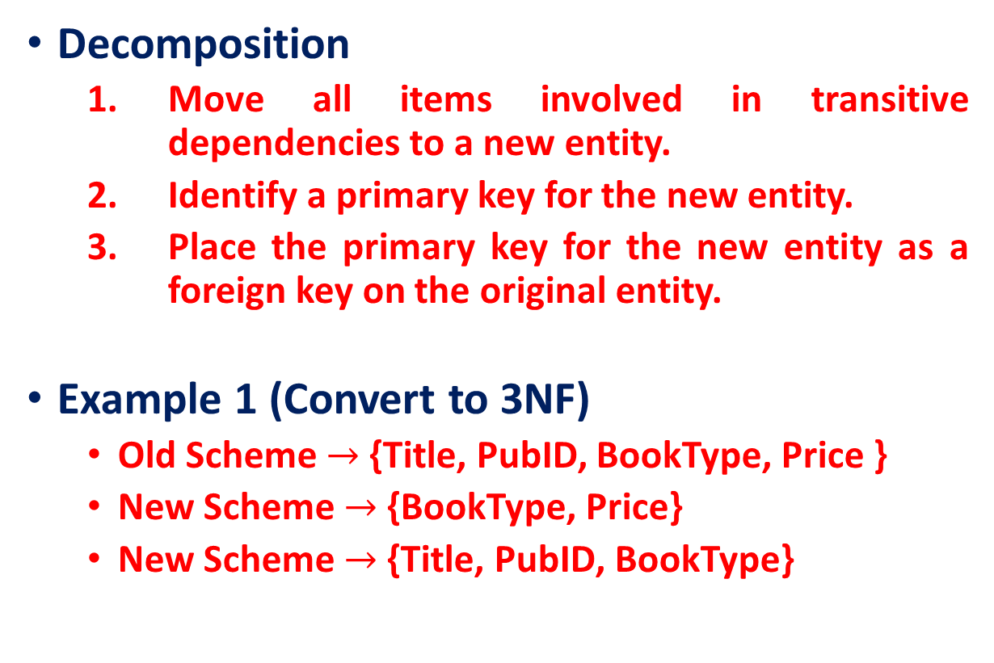
Third Normal Form (3NF)
Decomposition
Move all items involved in transitive dependencies to a new entity.
Identify a primary key for the new entity.
Place the primary key for the new entity as a foreign key on the original entity.
Example 1 (Convert to 3NF)
Old Scheme $→$ {Title, PubID, BookType, Price }
New Scheme $→$ {BookType, Price}
New Scheme $→$ {Title, PubID, BookType}

Slide 64
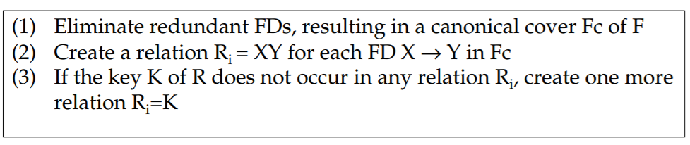

Third Normal Form (3NF)
Decomposition into 3NF
Given: relation R, set F of functional dependencies
Find: decomposition of R into a set of 3NF relation $R_{i}$
Algorithm:

Slide 65

Third Normal Form (3NF)
Given R(A,B,C,D,E), FDs = { A $→$ B, AB $→$D, B $→$BDE, C $→$D, D $→$ D }. Compute $F_{c}$

Slide 66
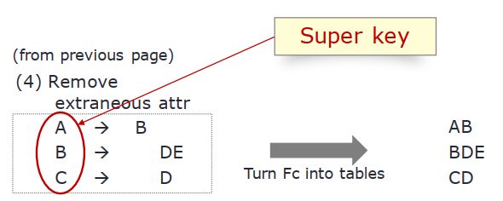
Third Normal Form (3NF)
A relation R(A, B, C, D, E) is converted into 3NF by putting LHS and RHS of each FD in Fc together in one relation.

Slide 67
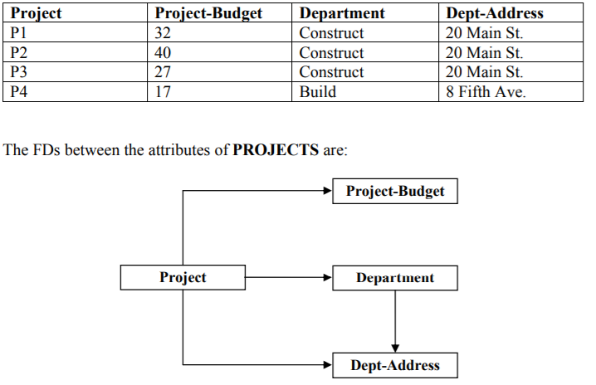
Third Normal Form
P→B, P→D, P→A, D→A
P→ABD, D→A
P→BD, D→A

Slide 68
Third Normal Form
Question:
Let an instance of relation schema R(A,B,C) with F = {A→B, A→C, B → A}?
Is this relation being in 3NF?
Yes, In 3NF, the right side of the FD can be a prime attribute.
Any issue, if we allow B → A ?
Redundancy, Anomalies [Example next page]
BCNF: 3NF + lossless join + redundancy free

Slide 69
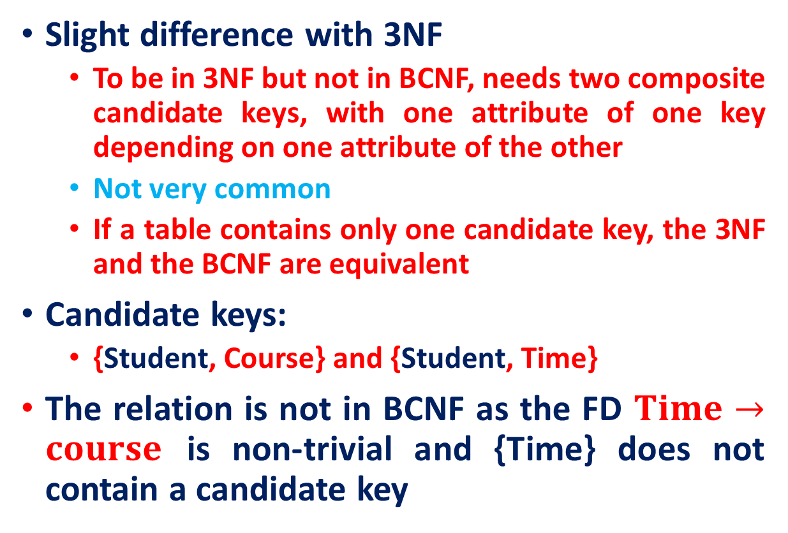
Boyce-Codd Normal form (BCNF)
Slight difference with 3NF
To be in 3NF but not in BCNF, needs two composite candidate keys, with one attribute of one key depending on one attribute of the other
Not very common
If a table contains only one candidate key, the 3NF and the BCNF are equivalent
Candidate keys:
{Student, Course} and {Student, Time}
The relation is not in BCNF as the FD $Time→course$ is non-trivial and {Time} does not contain a candidate key
StudentID | Course | Time
Ram | DBMS | 12:00
Shyam | DBMS | 12:00
Mohan | DBMS | 12:00
Sumit | DBMS | 12:00
Mohan | OS | 10:00
Shyam | OS | 10:00
Krishna | OS | 13:00

Slide 70

Third Normal Form: Anomalies
StudentID | Time
Ram | 12:00
Shyam | 12:00
Mohan | 12:00
Sumit | 12:00
Mohan | 10:00
Shyam | 10:00
Krishna | 13:00
Relation is not in BCNF as the FD $Time→course$ is non-trivial and {Time} does not contain a candidate key
StudentID | Course | Time
Ram | DBMS | 12:00
Shyam | DBMS | 12:00
Mohan | DBMS | 12:00
Sumit | DBMS | 12:00
Mohan | OS | 10:00
Shyam | OS | 10:00
Krishna | OS | 13:00
Time | Course
12:00 | DBMS
10:00 | OS
13:00 | OS
Redundancy

Slide 71
Third Normal Form: Anomalies
INSERT anomalies
You can’t add an empty class (class going to be schedule soon in future)
UPDATE anomalies
Moving the 12:00 class to 9:00 means changing four rows
DELETE anomalies
Deleting Krishna removes a stream
StudentID | Course | Time
Ram | DBMS | 12:00
Shyam | DBMS | 12:00
Mohan | DBMS | 12:00
Sumit | DBMS | 12:00
Mohan | OS | 10:00
Shyam | OS | 10:00
Krishna | OS | 13:00

Slide 72
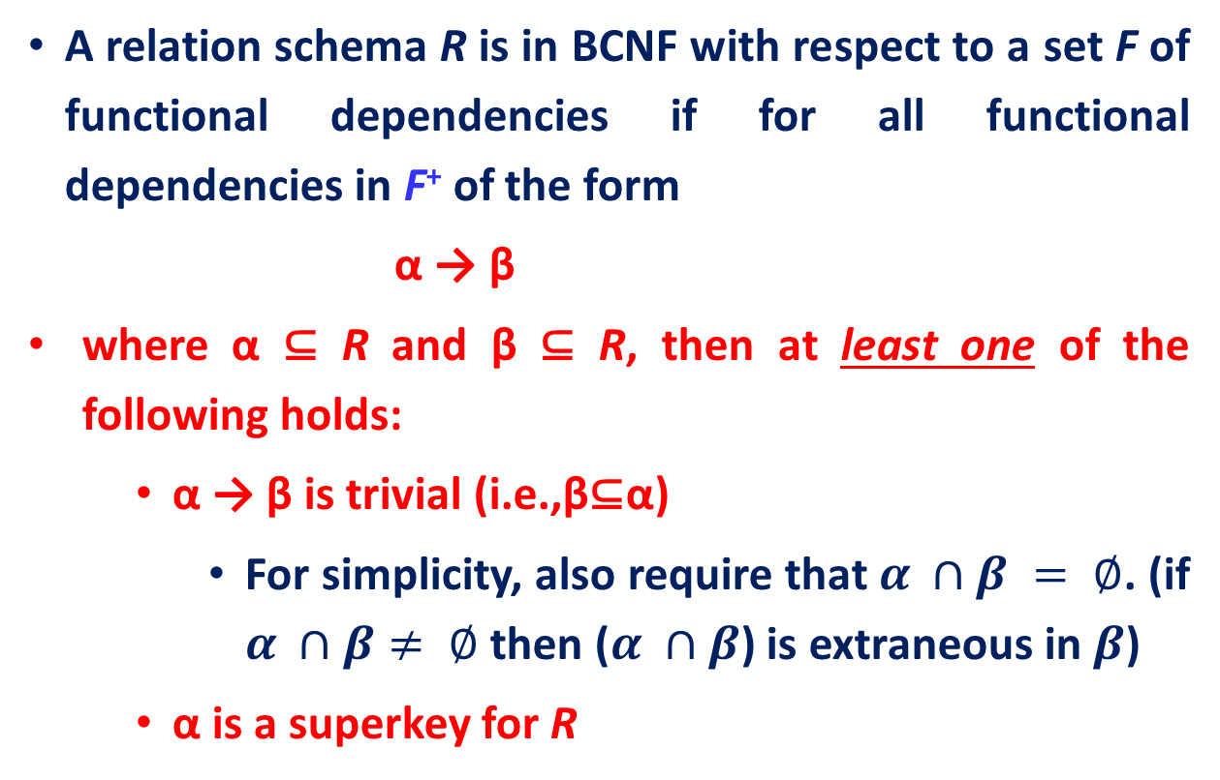
Boyce-Codd Normal Form (BCNF)
A relation schema R is in BCNF with respect to a set F of functional dependencies if for all functional dependencies in F⁺ of the form
α → β
where α ⊆ R and β ⊆ R, then at least one of the following holds:
α → β is trivial (i.e.,β⊆α)
For simplicity, also require that $α ∩β = ∅$. (if $α ∩β≠ ∅$ then ($α ∩β$) is extraneous in $β$)
α is a superkey for R

Slide 73
Boyce-Codd Normal Form (BCNF)
R: in_dep (ID, name, salary, dept_name, building, budget)
The functional dependency dept_name → budget holds on in_dep, but dept_name is not a superkey
We decomposed into the instructor and department schemas:
R1: instructor (ID, name, dept_name, salary)
R2: department (dept_name, building, budget)
The instructor schema is in BCNF. Similarly, the department schema is in BCNF

Slide 74

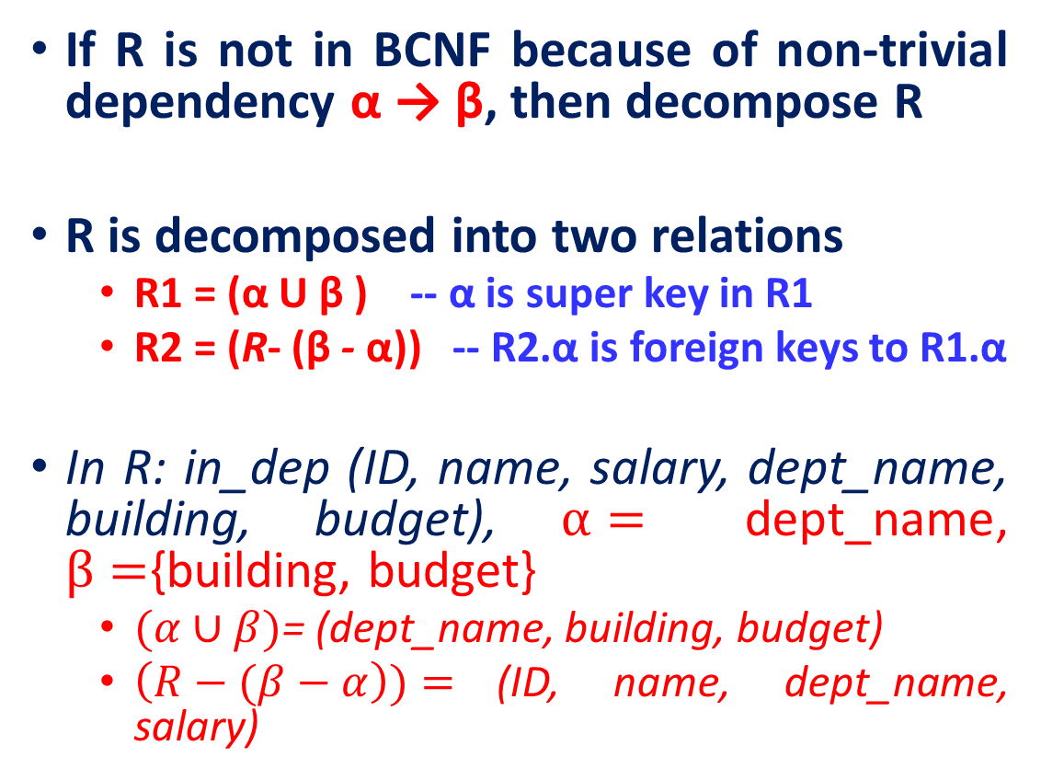


Boyce-Codd Normal Form (BCNF)
If R is not in BCNF because of non-trivial dependency α → β, then decompose R
R is decomposed into two relations
R1 = (α U β ) -- α is super key in R1
R2 = (R- (β - α)) -- R2.α is foreign keys to R1.α
In R: in_dep (ID, name, salary, dept_name, building, budget), $α=$ dept_name, $β=${building, budget}
$(α∪β)$= (dept_name, building, budget)
$\left(R−(β−α\right))=$(ID, name, dept_name, salary)
Others
$$α$$
$$β$$
R2
R1

Slide 75
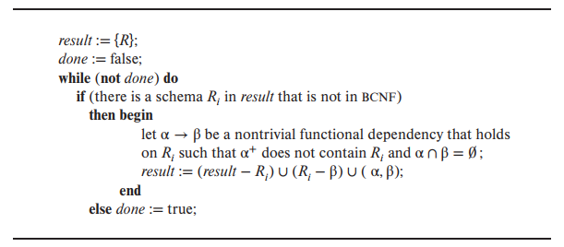
BCNF decomposition algorithm

Slide 76
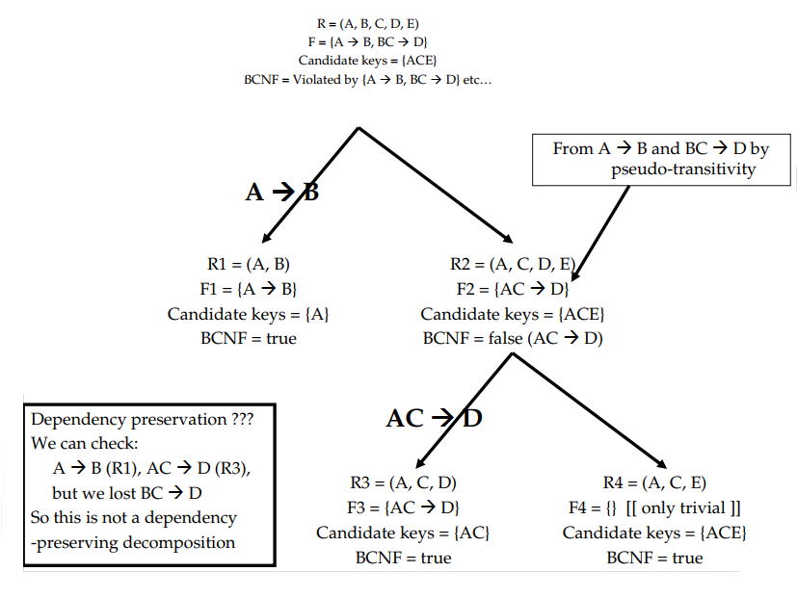
BCNF: Example
R2: R-(B-A): (A,B,C,D,E)-(B-A) = (A,B,C,D,E) – (B) = (A,C,D,E)

Slide 77
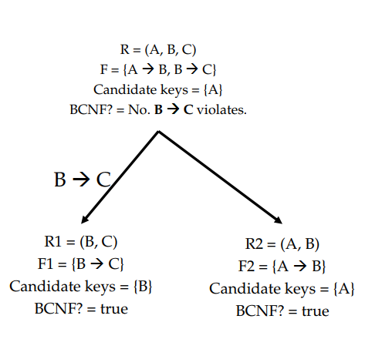
BCNF Decomposition: Example

Slide 78
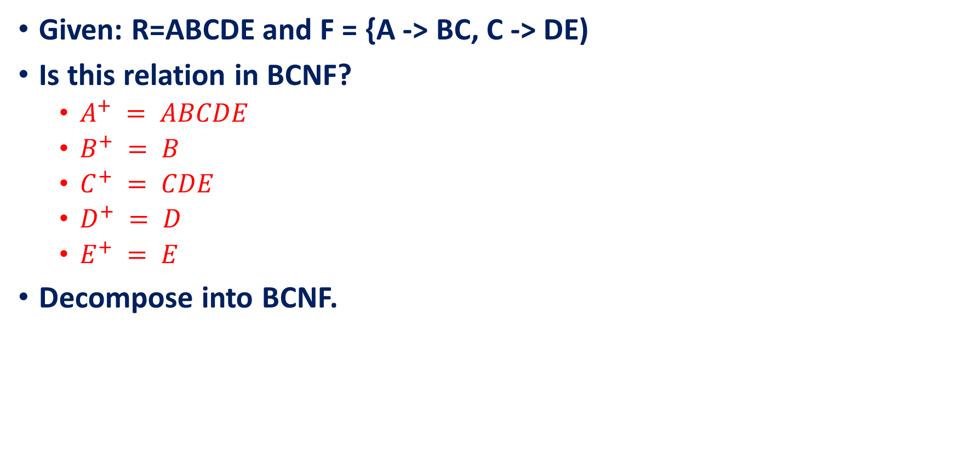
BCNF Decomposition: Example
Given: R=ABCDE and F = {A -> BC, C -> DE)
Is this relation in BCNF?
$A^{+} = ABCDE$
$B^{+} = B$
$C^{+} = CDE$
$D^{+} = D$
$E^{+} = E$
Decompose into BCNF.

Slide 79
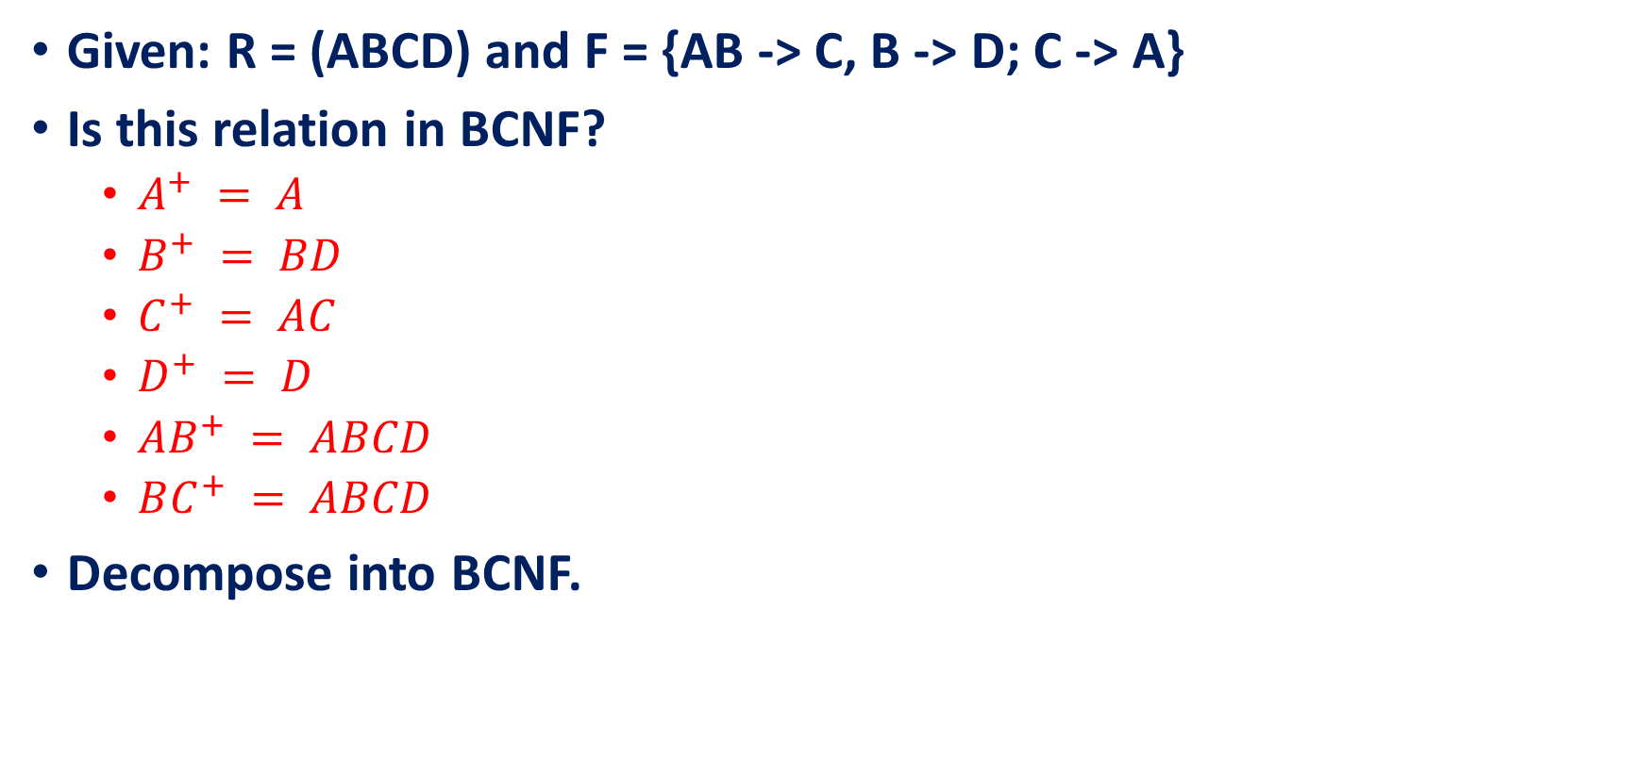
BCNF Decomposition: Example
Given: R = (ABCD) and F = {AB -> C, B -> D; C -> A}
Is this relation in BCNF?
$A^{+} = A$
$B^{+} = BD$
$C^{+} = AC$
$D^{+} = D$
$AB^{+} = ABCD$
$BC^{+} = ABCD$
Decompose into BCNF.

Slide 80


Multivalued Dependencies and Fourth Normal Form (4NF)
Functional Dependencies are not capable of representing all type of associations between attributes.
In general, a FD X→Y represents a many:1 relationship.
Sometimes we want to emphasize a many:many association or multiple 1:many relationships in the same table.
In this case multivalued dependencies might be more appropriated.
Equivalent 1NF relation

Slide 81
A New Form of Redundancy
Consider the following table.
Primary Key: {Course, Teacher, Text}
Is above table in BCNF and 3NF?
Yes, there are no non-trivial FDs, hence in BCNF
Course | Teacher | Text
M.Sc. CS | Prof. Amit | DBMS
M.Sc. CS | Prof. Amit | OS
M.Sc. CS | Prof. Shyam | DBMS
M.Sc. CS | Prof. Shyam | OS
MCA | Prof. Amit | DS
MCA | Prof. Amit | CO
MCA | Prof. Amit | DM

Slide 82

A New Form of Redundancy
Look Closely.
Is table containing certain patterns of data that resemble FDs
The dependencies are multi-valued dependencies (MVDs) written:
COURSE $↠$TEXT
COURSE $↠$ TEACHER
A $↠$ B is read:
Attribute B of relation R is multi-dependent on attribute A of relation R, or equivalently, attribute A of relation R multi-determines attribute B.
Course | Teacher | Text
M.Sc. CS | Prof. Amit | DBMS
M.Sc. CS | Prof. Amit | OS
M.Sc. CS | Prof. Shyam | DBMS
M.Sc. CS | Prof. Shyam | OS
MCA | Prof. Amit | DS
MCA | Prof. Amit | CO
MCA | Prof. Amit | DM

Slide 83
A New Form of Redundancy
Course | Teacher | Text
M.Sc. CS | Prof. Amit | DBMS
M.Sc. CS | Prof. Amit | OS
M.Sc. CS | Prof. Shyam | DBMS
M.Sc. CS | Prof. Shyam | OS
MCA | Prof. Amit | DS
MCA | Prof. Amit | CO
MCA | Prof. Amit | DM
Any issue?
For example, to add that MCA is also taught by Prof. Ram, we must make sure we add three tuples, one for each of the three MCA texts.
Better Design?
Replace the table by two projections
R1: CT (COURSE, TEACHER)
R2: CTEXT (COURSE, TEXT)
Course | Teacher
M.Sc. CS | Prof. Amit
M.Sc. CS | Prof. Shyam
MCA | Prof. Amit
Course | Text
M.Sc. CS | DBMS
M.Sc. CS | OS
MCA | DS
MCA | CO
MCA | DM

Slide 84


Multivalued Dependencies (MVD)
Let r(R) be a relation schema and let α ⊆ R and β ⊆ R.
The multivalued dependency
$$α ↠ β$$
holds on R if, in any legal instance of relation r(R), for all pairs of tuples $t_{1}$ and $t_{2}$ in r such that $t_{1}[α] = t_{2}[α],$there exist tuples $t_{3}$ and $t_{4}$ (not necessarily distinct) in r such that
$$t_{1}\left[α\right]= t_{2}\left[α\right]= t_{3}\left[α\right]= t_{4}\left[α\right]$$
$t_{3}[β] = t_{1}[β]$
$$t_{4}[β] = t_{2}[β]$$
$$t_{3}[R −(α∪β)] = t_{2}[R −(α∪β)]$$
$$t_{4}[R −(α∪β)] = t_{1}[R −(α∪β)]$$

Slide 85



Another way to look at it
The multivalued dependency
$$α ↠ β$$
holds on R if, two tuples of R agree on all the attributes of $α$, then their components in $β$ may be swapped, and the result will be two tuples that are also in the relation.
Observation
A multivalued dependency (or MVD) $α ↠ β$ specifies that given a particular value of $α$, the set of values of $β$ determined by this value of $α$ is completely determined by $α$ alone and does not depend on the values of the remaining attributes $γ$ of R.

Slide 86


Trivial Multivalued Dependencies Rules
A multi-valued dependency $α ↠ β$is trivial if and only if
$β=R−α$, or
$β ⊂α$
{Text} $↠$ {Course, Lecturer}
Note: If we have a nontrivial MVD in a relation, we may have to repeat values redundantly in the tuples (which is unwanted!).

Slide 87



Multivalued Dependencies Rules
Every FD is an MVD (promotion )
If $α → β$, then $α ↠ β$, i.e., swapping $β$’s between two tuples that agree on $α$ doesn't create new tuples.
Example, in Drinkers: $name ↠ addr$.
Drinkers(name, addr, phones, beersLiked) with MVD $name↠phones.$

Slide 88

Multivalued Dependencies Rules
Complementation rule:
If $α↠ β$holds on R, then $α ↠ R – (α∪β)$holds
Example: since $name↠phones$ holds in Drinkers, so does name $↠$ {addr, beersLiked}.
Drinkers(name, addr, phones, beersLiked) with MVD $name↠phones.$

Slide 89

Multivalued Dependencies Rules
Multivalued augmentation rule:
If $α↠β$holds, and $γ⊇δ$, then $αγ↠βδ$
Example: since $name↠phones$ holds in Drinkers, let $γ=\{addr, beersLiked\}$ and $δ=\{beersLiked\}$, so does
{name, addr, beersLiked} $↠$ {phones, $beersLiked$}.
Drinkers(name, addr, phones, beersLiked) with MVD $name↠phones.$

Slide 90


Multivalued Dependencies Rules
Multivalued transitivity rule: If 𝛼↠𝛽 and 𝛽↠𝛾 holds, then 𝛼↠𝛾−𝛽 holds
Example:
$A ↠BC$
$BC↠CD$
$A↠D (i.e. CD – BC)$
Multivalued Pseudo-transitivity rule: If $α↠β$and $βγ↠δ$ holds, then 𝛼$γ$↠ $δ$− $βγ$holds
Proof: https://www.researchgate.net/publication/221214699_A_Complete_Axiomatization_for_Functional_and_Multivalued_Dependencies_in_Database_Relations

Slide 91


Multivalued Dependencies Rules
Coalescence rule:
If $α↠β$and there exists$γ$such that $γ ∩β =φ$, and $γ→δ$, and $β⊇δ$, then $α→δ$
Example
$α=\left\{S\right\}, β=\{Day, Hour, Channel\}$
$γ=\{\text{TVstation}\text{\}, }δ=\{channel\}$
S $↠${Day, Hour, Channel}
TVstation → Channel
S → Channel
Similarly,
S $↠$ Sponsor
S $↠$Actor

Slide 92


Splitting Doesn't Hold
$name ↠\{areaCode phones\}$ holds, but neither $name ↠ areaCode$nor $name ↠ phones$do.

Slide 93

Inference rules for Multivalued Dependencies
Consider the dependencies $D = \{ A ↠ BC, DE ↠ C\}$ over the schema R = {ABCDE}.
Question Does $A↠C,AD↠C, AD↠BE$?
Solution:
$A↠BC$given
$A↠DE$by complementation respect to R
$DE↠C$given
$A↠C$transitivity on 2 and 3
$AD↠C$augmentation of 4 by D
$AD↠BE$complementation of 5 respect to R

Slide 94


Inference rules for Multivalued Dependencies
Consider the dependencies $D = \{ A ↠EI, C ↠AB\}$ over the schema R = {ABCDEI}.
Question Does $AC↠BCI$?
Solution:

Slide 95


Inference rules for Multivalued Dependencies
Consider the dependencies $D = \{ A ↠EI, C ↠AB\}$ over the schema R = {ABCDEI}.
Question Does $AC↠B$?
Solution:

Slide 96

Lossless Decomposition and MVDs
Let $R, R_{1}$and $R_{2}$ are the schema and D be the set of functional and multivalued dependencies on R
$R_{1}$ and $R_{2}$ form a lossless decomposition of $R$ if at least one of the following multovalued dependencies is in $D^{+}:$
$R_{1}∩R_{2}↠R_{1}$
$R_{1}∩R_{2}↠R_{2}$

Slide 97
Closures
For a set D of functional and multivalued dependencies, can compute closure D+
Use inference rules for both functional and multivalued dependencies to compute closure

Slide 98

4NF
A relation R is in 4NF if: whenever $α ↠β$is a nontrivial MVD, then $α$ is a superkey.
That is, all FD’s and MVD’s follow from “key → other attributes”
Nontrivial MVD means that:
$β$ is not a subset of $α$, and
$α$ and $β$ are not, together, all the attributes.

Slide 99

4NF Decomposition
Input: A universal relation R and a set of functional and multivalued dependencies D.
Method
Set result:= {R}
While there is a relation schema $R_{i}$ in result that is not in 4NF, do
{
choose a relation schema $R_{i}$ in result that is not in 4NF;
find a nontrivial MVD $α↠β$in $R_{i}$ that violates 4NF;
replace $R_{i}$ in result by two relation schemas $(R_{i} −β)$and $(α∪β)$;
}

Slide 100


4NF Decomposition
The restriction of D to $R_{i}$is the set$D_{i}$ consisting of:
All functional dependencies in $D^{+}$ that include only attributes of $R_{i}$.
All multivalued dependencies of the form $α ↠ β ∩ R_{i}$ where $α ⊆ R_{i}$and $α ↠ β is i$n $D^{+}$

Slide 101



4NF Decomposition
MVD:
Name →→ Child
Name →→ Phone
No FD
Decompose
MVDs become trivial

Slide 102

Summary of Normal Forms

Slide 103
References
Abraham Silberschatz, Henry F. Korth, and S. Sudarshan, Database System Concepts, 7/e
Adhsakkdi Y, Raghuram Krishnan and Johannes Gehrke, Database Management Systems, 3/e, TMH, 2007.
Some of the figures and Examples are taken from various online sources.
http://en.wikipedia.org/wiki/Boyce%E2%80%93Codd_normal_form

